Slide 1
Welcome to WORKDAY

Slide 2
What is WORKDAY?
Workday is a cloud-based software vendor that specializes in human capital management and financial management applications.
Headquartered in Pleasanton, Calif., Workday was founded in 2005 by Dave Duffield and Aneel Bhusri, former executives at PeopleSoft, an enterprise resource planning (ERP) software vendor later acquired by Oracle. Workday is a pioneer in software-as-a-service business applications, and Workday software has often been recognized for its ease of use and quick implementation, compared with on-premises HCM and finance applications. The company does not officially consider itself Workday ERP, but it is widely considered to be in direct competition with ERP vendors, including Oracle and SAP.

Slide 3
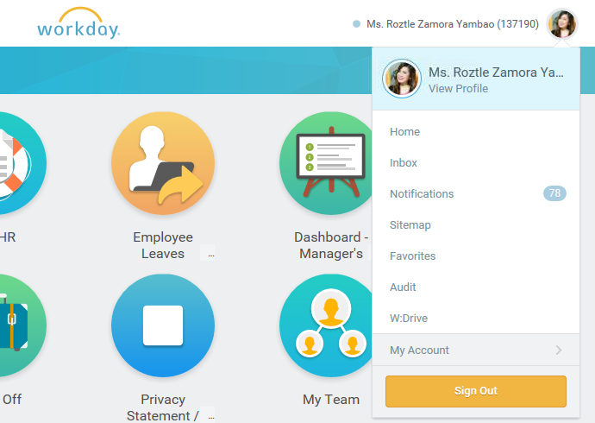
Your WORKDAY Profile
Here’s your profile.
You can see your personal information here which are confidential and should not be seen by other employees (e.g. compensation)
Click the image after your name to see the menu.
Click “View Profile”

Slide 4
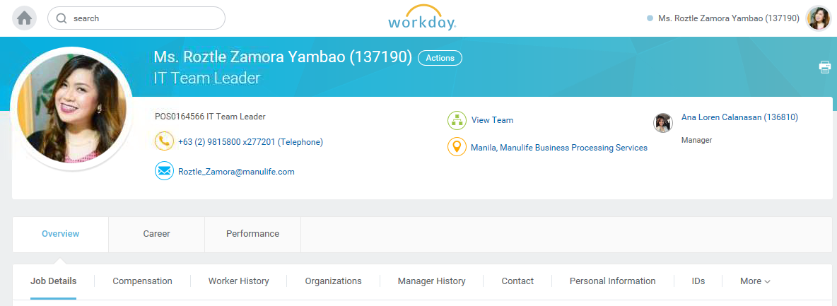
Manage your PROFILE
Overview Tab on the lower left shows your Employee Information
Click “ACTIONS” after your name

Slide 5
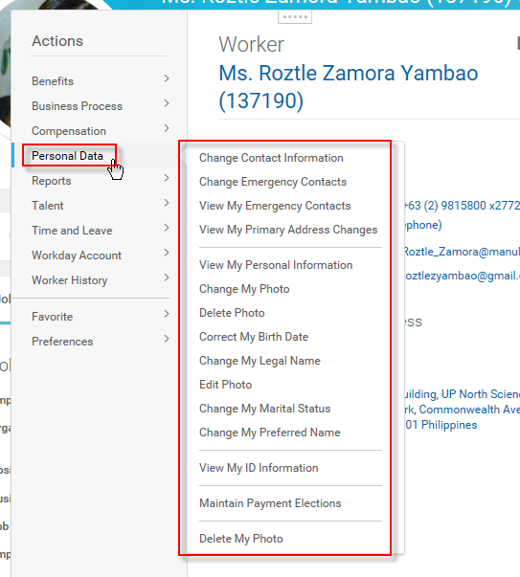
Manage your PROFILE
Under the ACTIONS tab, you may modify your Workday Profile.
Choose “PERSONAL DATA” and select from the list.
(e.g. Change My Photo or Change my Preferred Name)

Slide 6
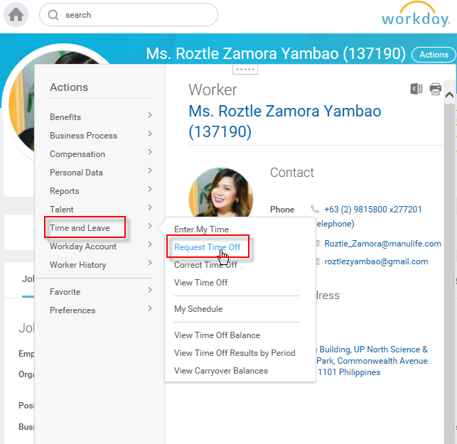
Request for LEAVES (VL, SL, EL)
Under the ACTIONS tab, you may Request for your time off.
Choose “Time and Leave”
Vacation
Sick
Emergency
Etc.

Slide 7
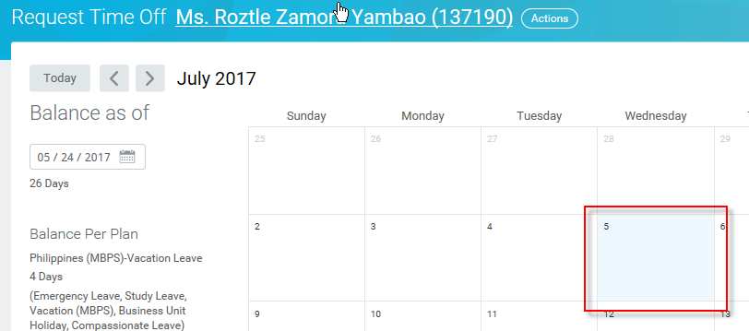

Request for LEAVES (VL, SL, EL)
Click on the box (desired off date)
Then click the box on the lower left “1 Day- Request Time Off” and fill-out the necessary details in the pop-up window (see image on the next slide.)

Slide 8
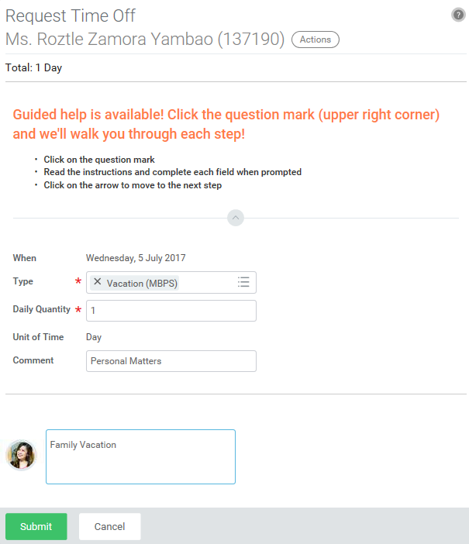
Request for LEAVES (VL, SL, EL)

Slide 9
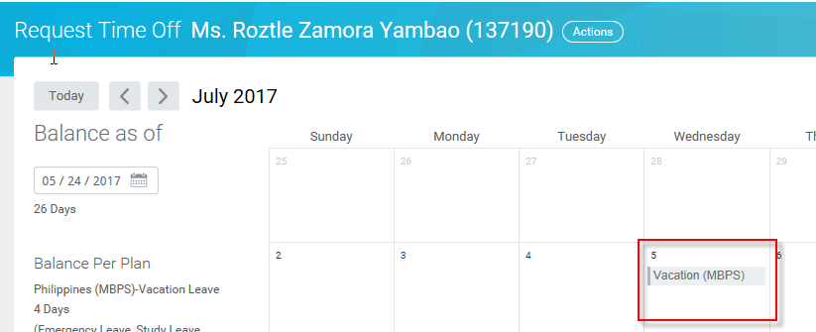
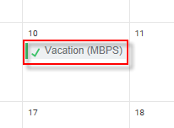
Request for LEAVES (VL, SL, EL)
Once your request time off has been submitted, you will see the chosen date with gray line (see image above) which means your manager needs to approve it. Once approved, it will be changed to a green check mark (see image on the left)

Slide 10
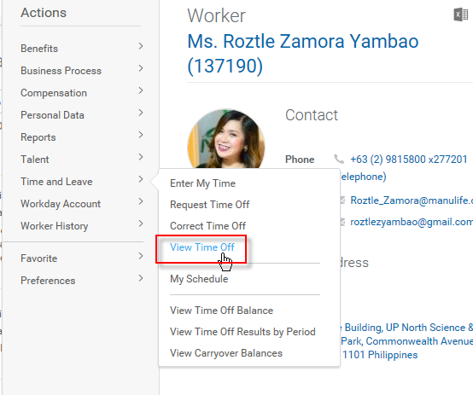
Request for LEAVES (VL, SL, EL)
Under the ACTIONS tab, you may View your requested time off.
Choose
>Time and Leave
> View Time Off

Slide 11
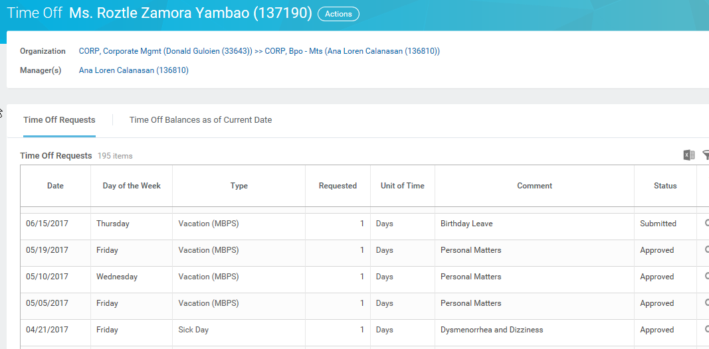
Request for LEAVES (VL, SL, EL)
The image below shows all your time off and their status (approved, submitted, cancelled, etc.)

Slide 12

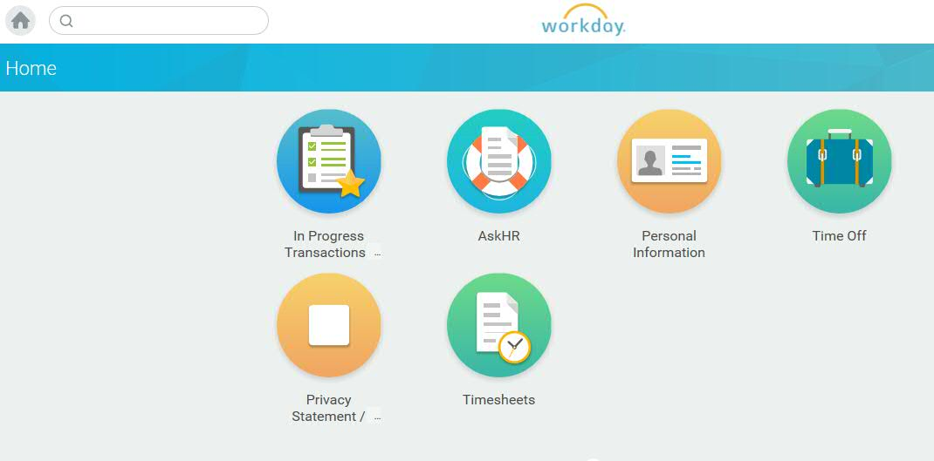
AskHR Guide
For other inquiries, questions and guide for WORKDAY, you may go back to your Workday Homepage and click the AskHR icon.

Slide 13
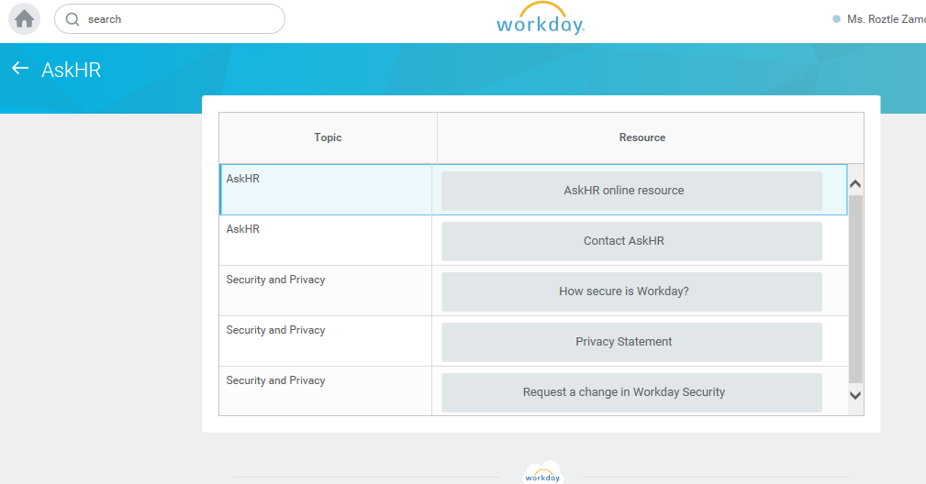
Getting Started
AskHR is a tool in guiding you for all your concerns with regard to Workday. Click the “AskHR online resource” to walk you through what you needed to know.

Slide 14
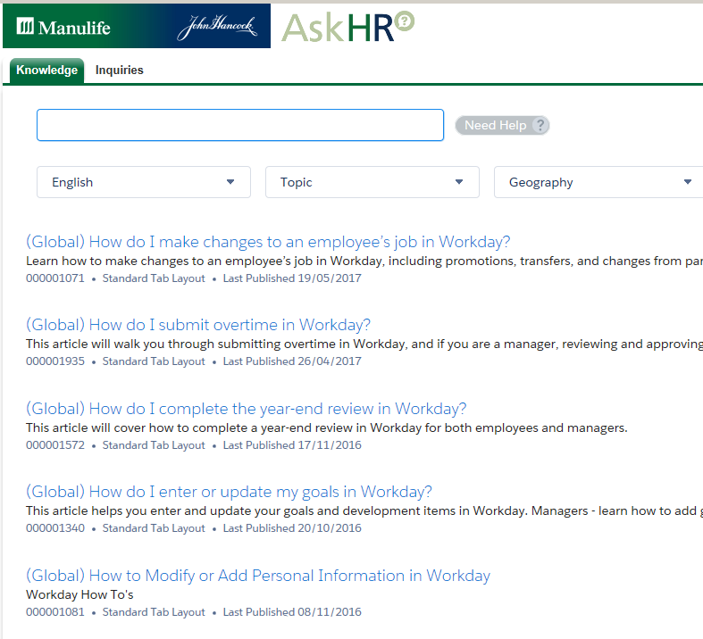
AskHR Guide
Here’s a sample of some How to’s.
Type your keywords in the search field.
On the next slide we are giving you an example on How to submit your overtime in Workday.
Simply follow the steps ☺

Slide 15
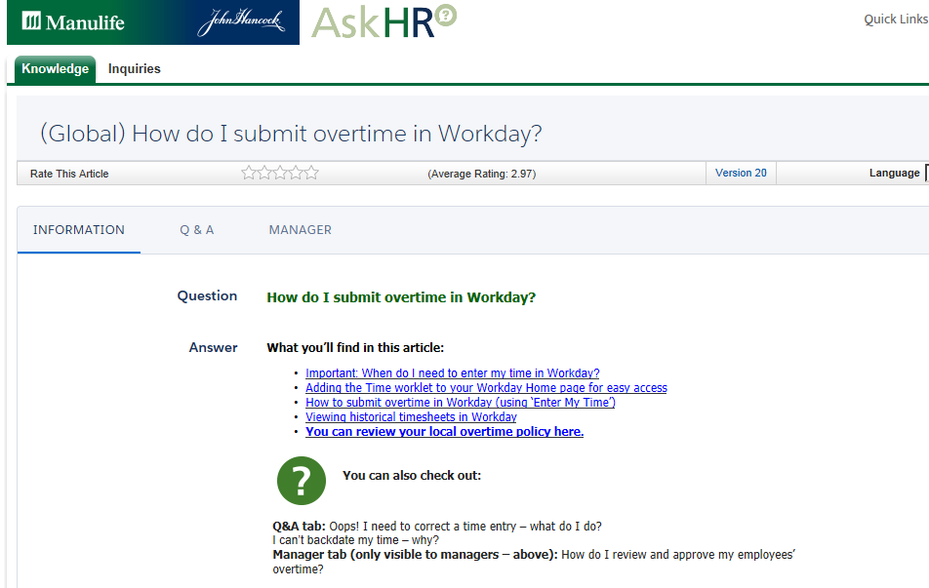
(Global) How do I submit overtime in Workday?

Slide 16
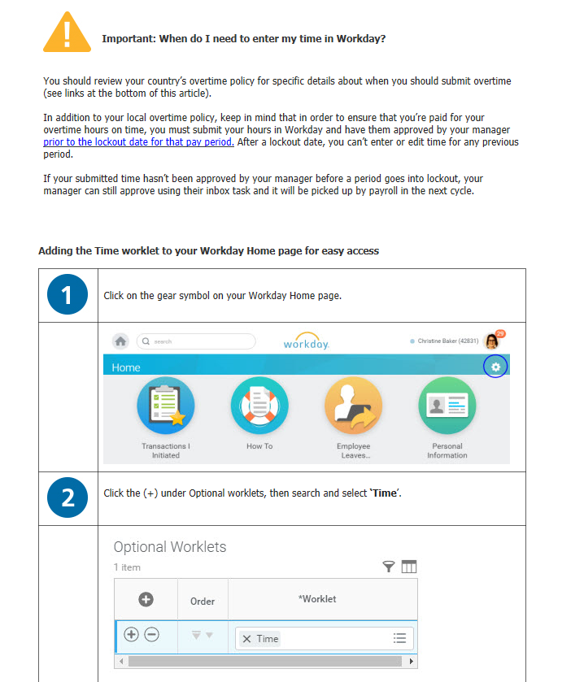
(Global) How do I submit overtime in Workday?

Slide 17
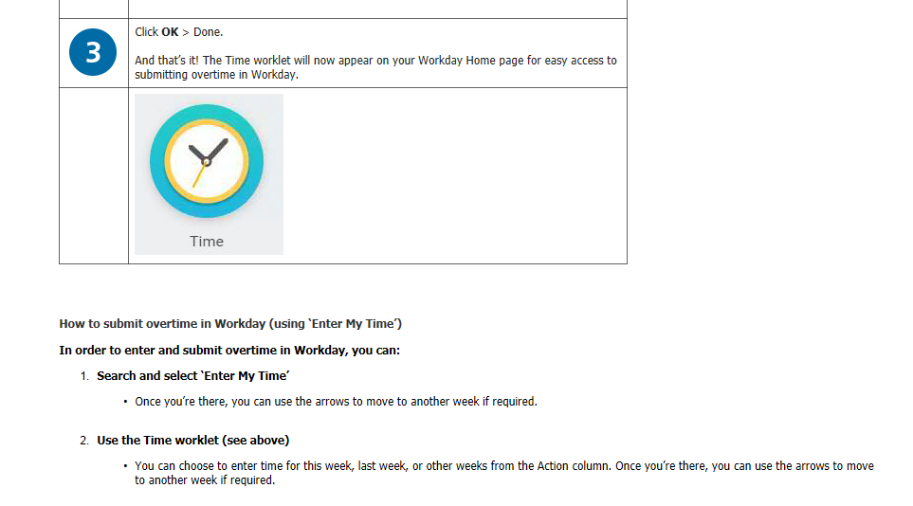
(Global) How do I submit overtime in Workday?

Slide 18
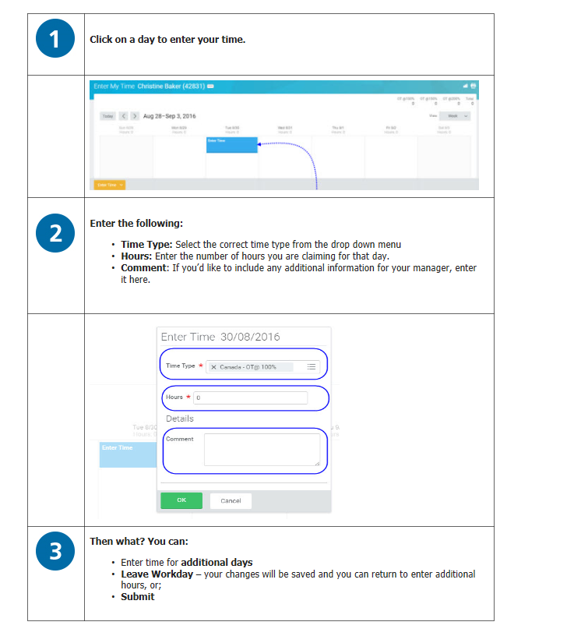
(Global) How do I submit overtime in Workday?

Slide 19
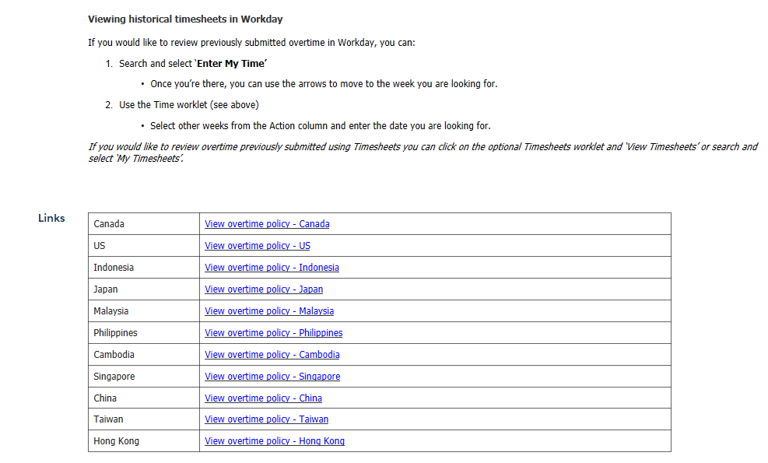
(Global) How do I submit overtime in Workday?

Slide 20
Thank you
We operate as John Hancock in the United States and Manulife in other parts of the world.

